Slide 1

Zomato Restaurants Data Analysis

Slide 2
Problem Statement
You are hired as a consultant data analyst by zomato where the team is looking for expansion and opening restaurants. Your task is to come up with strategies/suggestions about opening newer restaurants.

Slide 3
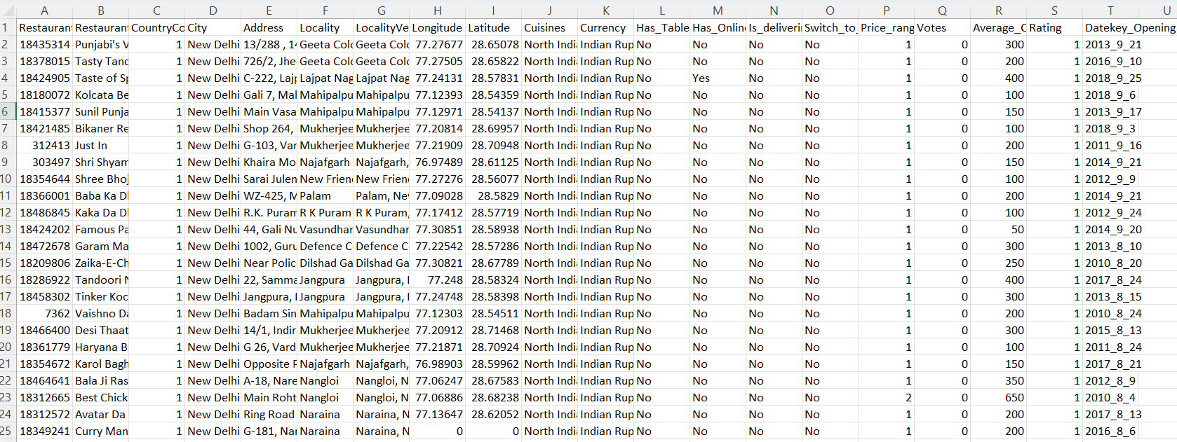
Following is the Dataset :

Slide 4
Data Overview
Has_Table_booking: Indicates whether the restaurant has a table booking option (Yes/No).
Has_Online_delivery: Indicates whether the restaurant offers online delivery (Yes/No).
Is_delivering_now: Indicates whether the restaurant is currently delivering (Yes/No).
Switch_to_order_menu: Indicates whether users can switch to the order menu (Yes/No).
Price_range: A numeric value indicating the price range category of the restaurant.
Votes: The number of votes or ratings/(feedback) received by the restaurant.
Average_Cost_for_two: The average cost for two people dining at the restaurant.
Rating: The overall rating of the restaurant is based on user reviews
Datekey_opening: The date when the restaurant was opened.
Has_Table_booking: Indicates whether the restaurant has a table booking option (Yes/No).
Has_Online_delivery: Indicates whether the restaurant offers online delivery (Yes/No).
Is_delivering_now: Indicates whether the restaurant is currently delivering (Yes/No).
Switch_to_order_menu: Indicates whether users can switch to the order menu (Yes/No).
Price_range: A numeric value indicating the price range category of the restaurant.
Votes: The number of votes or ratings/(feedback) received by the restaurant.
Average_Cost_for_two: The average cost for two people dining at the restaurant.
Rating: The overall rating of the restaurant is based on user reviews.

Slide 5
Analytical approach and tools
Cleaning data in Excel involves several manual steps and built-in functions.
Steps which I followed to Data cleaning in excel.
Open the Dataset
Load your Excel file containing the data.
Identify Missing Values
Use Conditional Formatting to highlight missing values.
Standardize Text Data
Use the TRIM function to remove extra spaces
Remove Duplicates
Select your dataset, go to the Data tab, and click on Remove Duplicates.
Choose which columns to check for duplicates.
Created additional Columns
I have added an additional columns to summarize the number of missing values.
Corrected The Data Types
a . Ensured the columns are formatted Correctly

Slide 6
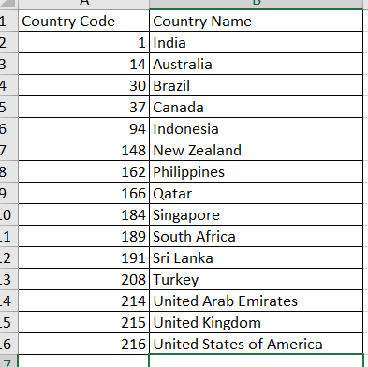
Analytical approach and tools
I have used the V look up function to fill up countries in the original data using the country code here below are the steps which I followed to implement v-look up function to alter the data.
Steps to perform v-lookup:
Open Excel Workbook:
Ensured both the Original Data and Lookup Table are in the same workbook.
Identify Data Locations:
Original Data where I need to fill the country names using country code is present in country description
Lookup Table is present in RAW data sheet
Select the Cell for Formula:
Go to the Original Data sheet. Click on cell to apply formula to fetch the country name using the country code. (here I have selected B2 cell in Country description sheet)
Enter VLOOKUP Formula:
In cell B2, type:
=VLOOKUP(A2, Lookup!A:B, 2, FALSE)
Copy Formula Down:
Drag the fill handle down from B2 to apply the formula to other rows
Optional: Handle Errors:
To avoid #N/A errors for missing codes, modify the formula in B2 to:
=IFERROR(VLOOKUP(A2, Lookup!A:B, 2, FALSE), "Not Found")

Slide 7
Analytical approach and tools
Key Observations:
India:
Dominates the chart with a significantly high number of restaurants (8652). This suggests a robust restaurant industry or a recent surge in openings.
Other Countries:
Countries like the Philippines, Indonesia, Qatar, Singapore, and South Africa have similar low numbers, ranging from 20 to 60 restaurants.
Australia, Brazil, Canada, and Turkey have very few openings, with Canada having only 4.
United States:
Appears twice in the chart, with one bar showing 434 restaurants, indicating a notable presence but still far less than India.
General Insights:
Disparity: There is a stark contrast between India and the other countries, highlighting a unique market or growth opportunity in India.
Low Numbers Elsewhere: Most countries have relatively low numbers of restaurant openings, suggesting either market saturation or slower growth in those regions.
Potential for Growth: The data may indicate potential for growth in the restaurant sector in countries with fewer openings.
Conclusion:
The chart effectively illustrates the significant difference in restaurant openings between India and other countries, emphasizing India's leading position in this context.
Row Labels | Count of RestaurantID
Australia | 24
Brazil | 60
Canada | 4
India | 8652
Indonesia | 21
New Zealand | 40
Philippines | 22
Qatar | 20
Singapore | 20
South Africa | 60
Sri Lanka | 20
Turkey | 34
United Arab Emirates | 60
United Kingdom | 80
United States of America | 434
Grand Total | 9551

Slide 8
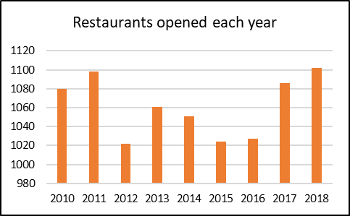
Analytical approach and tools
Key Observations:
2010 and 2011:
Both years show a high number of restaurant openings, with 2011 peaking slightly above 1100. This suggests a strong growth trend in the restaurant industry during this period.
2012:
There is a noticeable drop in the number of openings, indicating a potential slowdown or market saturation.
2013 to 2015:
The years show relatively low numbers, with 2014 being the lowest point. This could reflect economic challenges or changing consumer preferences affecting new restaurant launches.
2016:
A significant rebound occurs, with openings rising again, suggesting a recovery in the market or renewed interest in dining out.
2017 and 2018:
Both years maintain a high level of restaurant openings, similar to the peak years of 2010 and 2011. This indicates a strong and possibly growing restaurant sector.
General Insights:
Fluctuations: The data shows fluctuations in restaurant openings, with notable peaks and troughs, reflecting the dynamic nature of the restaurant industry.
Sustained Growth: The consistent high numbers in the last two years indicate a positive trend for the restaurant industry, potentially driven by factors such as population growth, urbanization, or changing consumer habits.

Slide 9
Analytical approach and tools
Key Observations:
Price Range Distribution:
The chart shows three distinct price ranges, with varying numbers of restaurants in each category.
The first price range (likely the lowest) has 4444 restaurants, indicating a strong presence of budget-friendly options.
The second price range has 3113 restaurants, suggesting a moderate offering in this category.
The third price range (the second highest) has 1408 restaurants, indicating fewer high-end options available.
The fourth price range (the highest) has 586 restaurants, indicating fewer high-end options available
Dominance of Budget Options:
The highest number of restaurants is in the lowest price range, which may reflect consumer preferences for affordable dining options.
Limited High-End Options:
The low number of restaurants in the higher price range could suggest either a lack of demand for high-end dining or potential market opportunities for upscale establishments.
General Insights:
Market Focus: The data indicates a market focus on budget-friendly dining, which may align with the target demographic or economic conditions.
Opportunity for Growth: The limited number of higher-priced restaurants suggests an opportunity for expansion in that segment, especially if there is a demand for upscale dining experiences.

Slide 10
Analytical approach and tools
Key Observations
Dominant Cuisines:
North Indian cuisine is the most represented, with a significantly high number of restaurants, indicating a strong local preference.
Fast Food also shows a notable presence, reflecting a demand for quick and convenient dining options.
Variety and Gaps:
While there is a wide range of cuisines listed, many have low representation, such as Afghani, Turkish, and Street Food. This suggests that while diversity exists, certain cuisines dominate the market.
Trends:
The presence of Desserts, Ice Cream, and Juices indicates a trend towards sweet and refreshing options, appealing to a broad audience.
Conclusion
The chart highlights a diverse culinary landscape, with North Indian and Fast Food dominating. Understanding these trends can help restaurant owners tailor their offerings to meet local preferences and explore new culinary opportunities.

Slide 11
Analytical approach and tools
Key Observations
High Voter Engagement:
Brazil and Indonesia show the highest average number of voters, indicating strong civic engagement and participation in the electoral process. This suggests a robust democratic culture in these countries.
Moderate Participation:
Countries like Singapore, Canada, and Australia have moderate voter numbers. This may reflect stable political environments but could also indicate challenges in mobilizing voters.
Lower Voter Numbers:
Countries such as Turkey, United Arab Emirates, and Qatar have lower average voter numbers. This could suggest various factors, including political structures, voter apathy, or restrictions on voting.
Comparative Analysis:
The significant differences in voter numbers across countries highlight varying levels of political engagement and the effectiveness of electoral systems in encouraging participation.
Conclusion
The chart illustrates a clear disparity in voter engagement across different countries, with Brazil and Indonesia leading in participation. Understanding these trends can help policymakers and political organizations develop strategies to enhance voter turnout and engagement in countries with lower participation rates.

Slide 12
Analytical approach and tools
Key Observations
Cost Distribution:
The majority of restaurants fall within a lower price range, particularly around ₹200 to ₹800, indicating that affordable dining options are prevalent.
There are noticeable peaks at specific price points, particularly around ₹360 and ₹720, suggesting these are common price ranges for meals for two.
Outliers:
A few restaurants have significantly higher costs, reaching up to ₹350,000. These outliers may represent high-end dining establishments or luxury experiences.
Frequency:
The frequency of restaurants decreases as the cost increases, indicating that more expensive dining options are less common compared to mid-range and budget-friendly options.
General Insights
Consumer Preferences: The concentration of restaurants in the lower to mid-range price points suggests a strong market for affordable dining, catering to a wide audience.
Market Opportunities: The presence of high-cost outliers indicates a niche market for luxury dining, which could attract affluent customers.

Slide 13
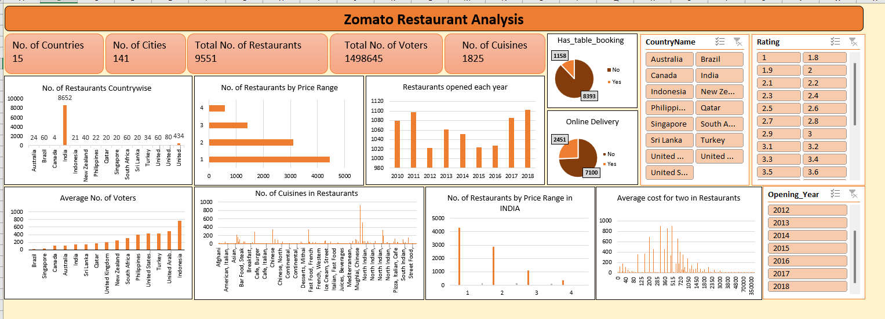
DASH BOARD

Slide 14
CONCLUSION
The analysis on dataset shows countries having the greater number of restaurants, and the services provided by restaurants in different countries and cities like online delivery and table booking.
We identified the most popular cuisines in the area based on the number of restaurants and user ratings.
We examined the correlation between restaurant pricing and customer ratings and found out that the correlation in 0.31 which means restaurant pricing and customer ratings are loosely correlated.
To sum up, Zomato restaurant data research may provide a thorough grasp of the regional eating scene, empowering businesses and other stakeholders to improve consumer experiences, make wise decisions, and take advantage of new trends.

Slide 15
Thank you
Ekta Sahni

